Slide 1
What is id NodeJS
Node is not a language.
This is the server environment.
NodeJS Connect with database.
Code and syntax is very similar to JavaScript.
But not exactly the same.
NodeJS free open source.
NodeJS use Chrome’s V8 engine to execute code.
Page No. 54 .Start API Creation

Slide 2
Why do we do NodeJS
NodeJS mostly used for API.
So we can connect the same database with Web, APP, Mobile APP
Node is easy to understand who know the JavaScript.
Node is super-fast for API.
With Node and JavaScript, you can become a full stack developer.
History and More…
First Release : May 27 2009
Current Version:20.16.
Written in C, C++, JavaScript.

Slide 3
Basic before Getting start
What are client and server side.
Where do we use node(Client or Server Side).
How NodeJS use JavaScript.
What developer Make with NodeJS.

Slide 4
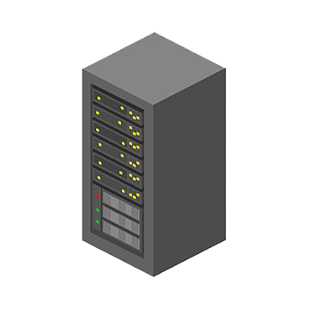

Client and Server Sides
Request
Response
Client
Server

Slide 5
Client and Server Sides
Request
Response
Client
Server
JavaScript, Html, CSS
NodeJS

Slide 6



Client and Server Sides
Results
JavaScript Code
JavaScript Code
Results
Written in C++

Slide 7

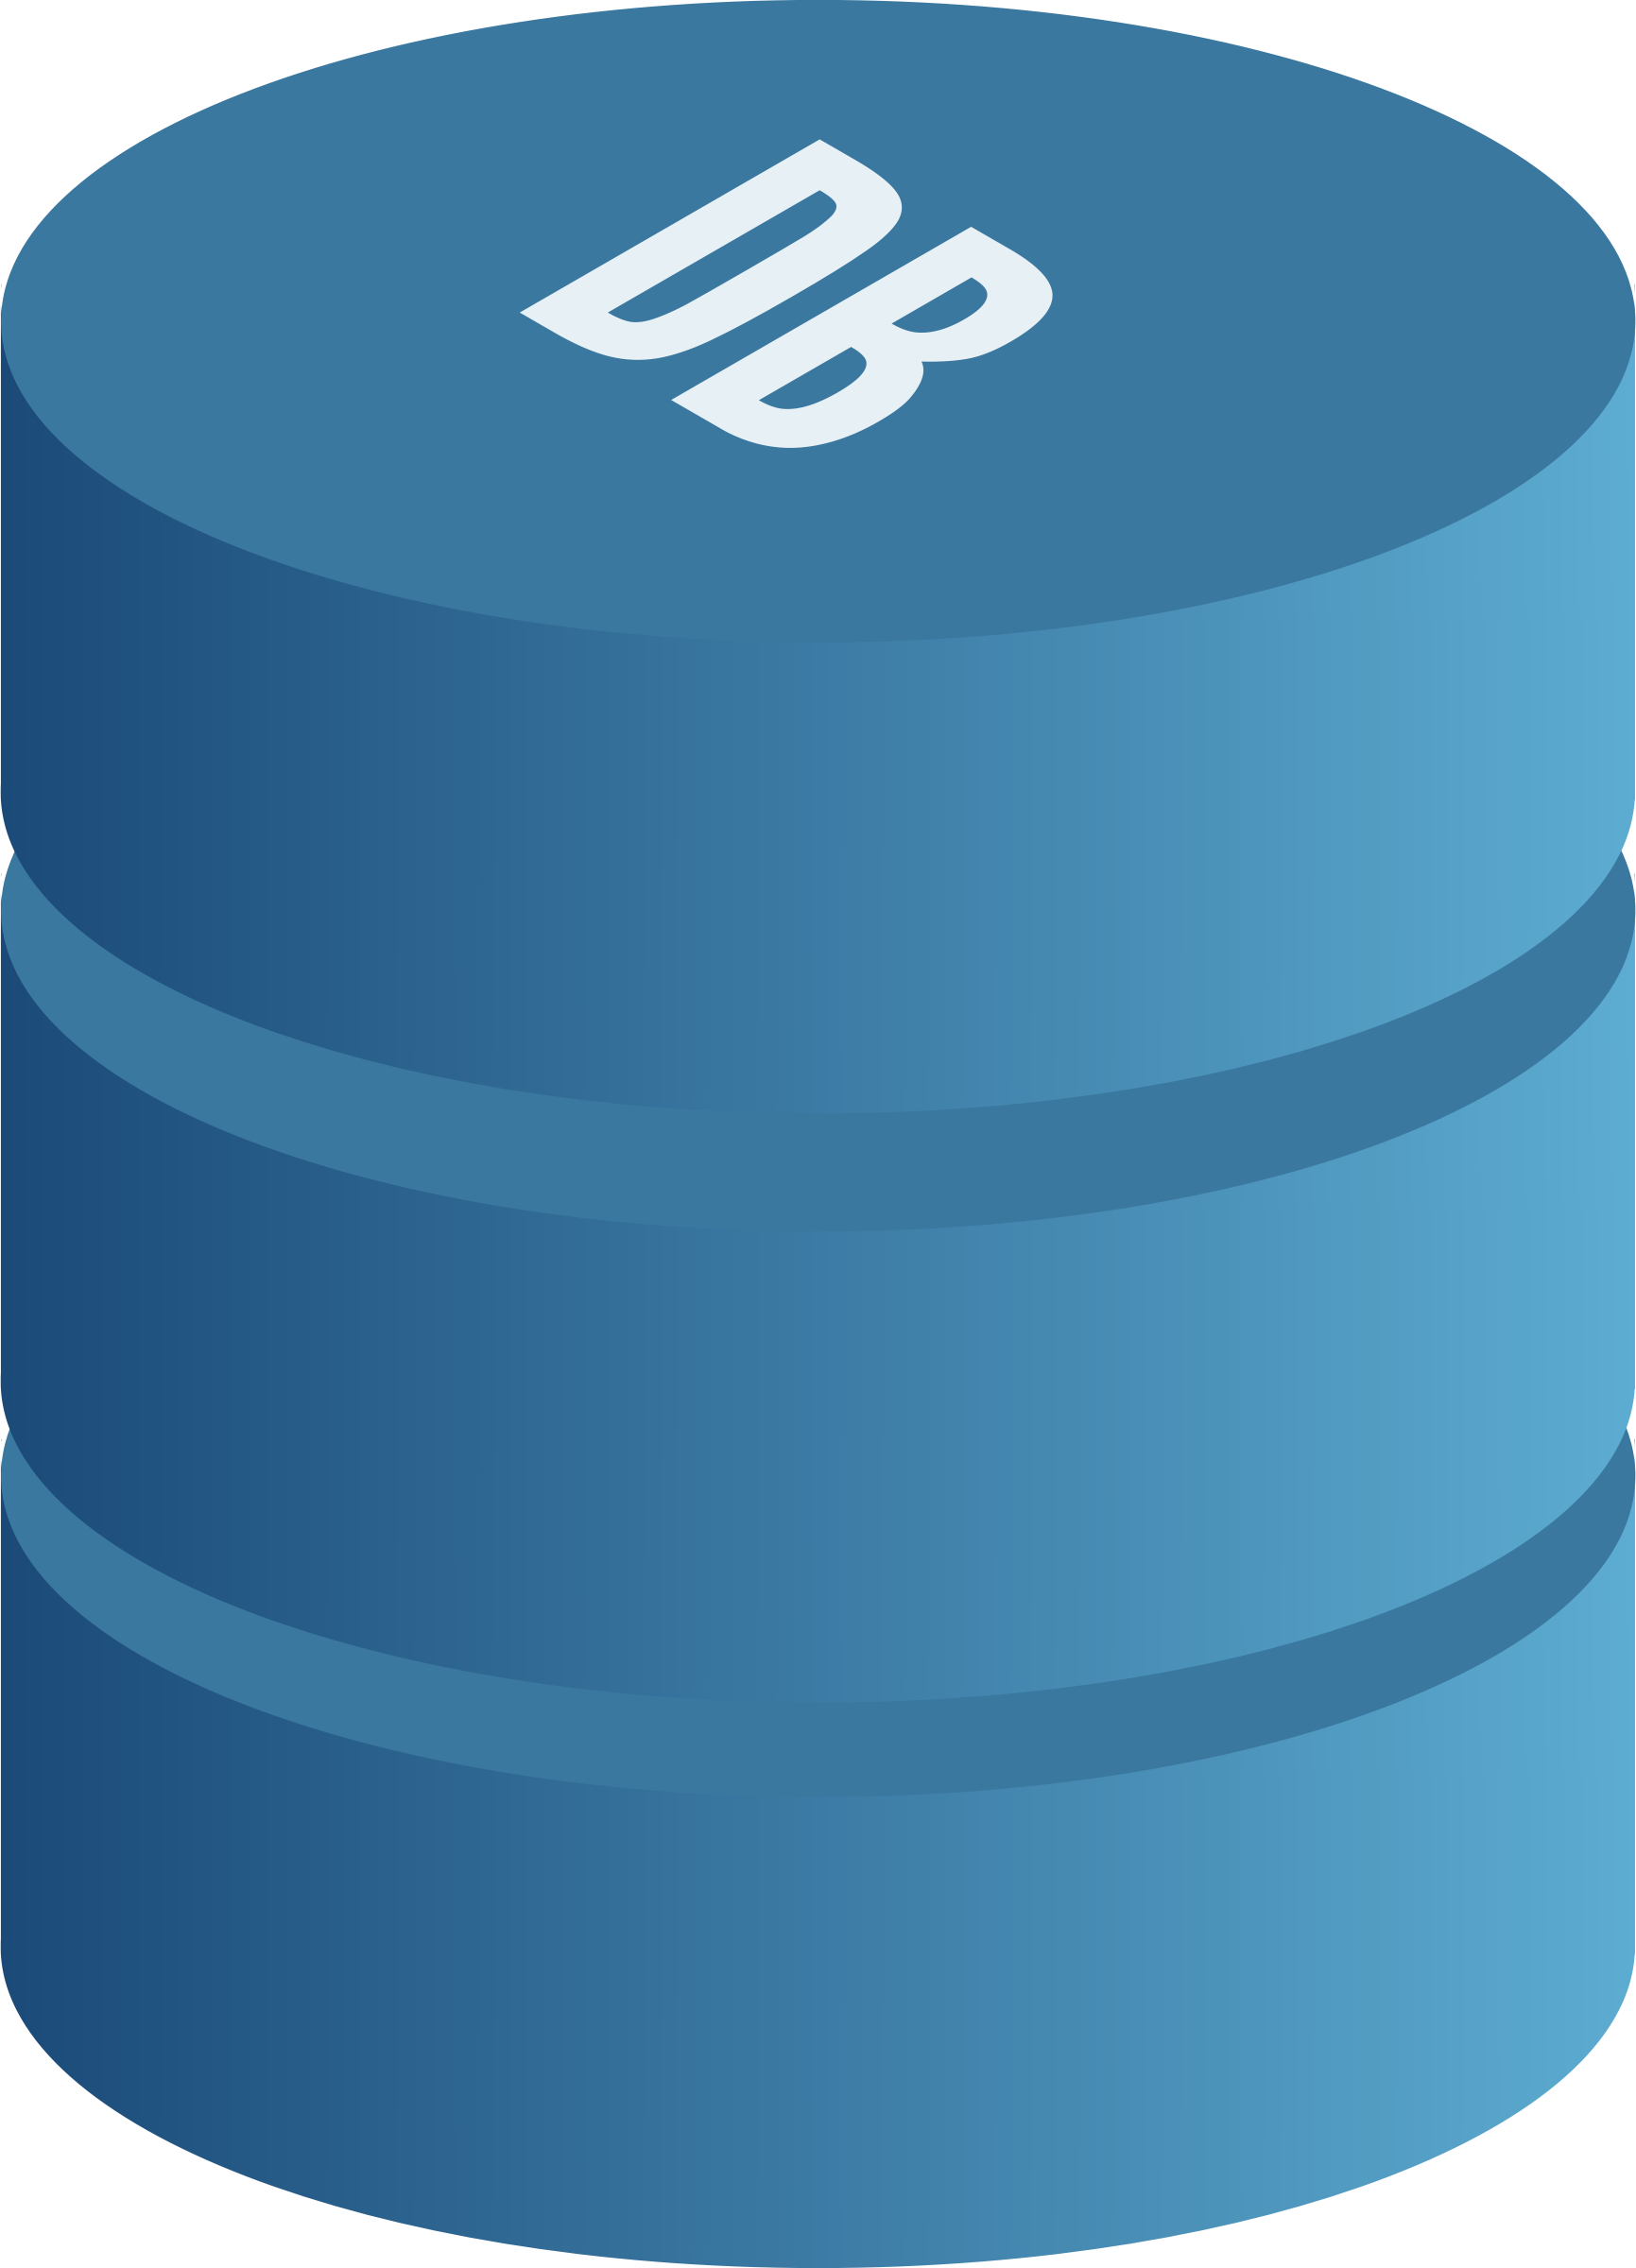


What developer make wit NodeJS
Front-End/Back-end
Web App
Database
Server
Mobile App
File Server

Slide 8
Install and Setup NodeJS
Download Node JS
Install NPM and Node.
List of Recommended code editor.

Slide 9
First script with node
Script with command line
Make folder and file.
Write first code and run.

Slide 10
Fundamentals of NodeJS
JavaScript fundamentals for NodeJS.
Conditions, Loop, and Array
The import function and variables from another file.

Slide 11
Core Module in NodeJS
What are the core modules ?.
What are the global modules.
Global module example.
Non-global module with Example.
Core modules:- Core modules are built in modules that include. Ex. FD, buffer, Http etc.
Non-global module: it is typically export the module is called non-global module

Slide 12
Make Basic server output on browser
Make basic server.
Function as parameter in node.
Arrow function
Get output on browser
http.createServer((req, resp) => {
resp.write("<h2>Hello, This is Alok Singh</h2>");
resp.end();
}).listen(8000);
const http = require('http');
http.createServer((req,resp)=>{
resp.write("<h2>Hello, This is Alok Sing</h2>");
resp.end();
}).listen(8000);
function dataControll(req,resp){
resp.write("<h2>Hello, This is Alok Singh</h2>");
resp.end();
}
http.createServer(dataControll).listen(8000);
http.createServer((req,resp)=>{
resp.write("<h2>Hello, This is Alok Singh</h2>");
resp.end();
}).listen(8000);

Slide 13
All About Package.Json
What is package.Json file.
How to make it.
Check the file in detail.
Install external package.
Package.json:- it kept have the project details. Meana it kept code related details.

Slide 14
Nodemon | Time saving module
What is Nodemon package ?
How to install it ?.
How to use it ?.
Nodemon:- Nodemon is a tool that helps develop Node.js based applications by automatically restarting the node application when file changes in the directory are detected.

Slide 15
Make a simple API
Make a server.
Create header and API body.
Create and API with static data
Put data in another file.
const htpp = require('http');
htpp.createServer((req, resp)=>{
resp.writeHead(200,{'content-type':'application\json'});
resp.write(JSON.stringify([{name:"Alok Singh",email:"aloksingh@gmail.com"},
{name:"Aasth Bharti",email:"bharti.17@gmail.com"},
{name:"Anshika Bharti",email:"bharti.01@gmail.com"},
{name:"Raja",email:"raja23@gmail.com"}]));
resp.end();
}).listen(4500);
const htpp = require('http');
const data = require('./data');
htpp.createServer((req, resp)=>{
resp.writeHead(200,{'content-type':'application\json'});
resp.write(JSON.stringify(data));
resp.end();
}).listen(4500);

Slide 16
Input from command line
Set input from command line
Create file with input.
Delete file with input.
Aargument Vector
const fs = require('fs');
const input = process.argv;
if(input[2] == 'add')
{
fs.writeFileSync(input[3],input[4]);
}else if(input[2] == 'remove')
{
fs.unlinkSync(input[3]);
}
else{
console.log('invalid input');
}
D:/node24>node index.js add data.txt ‘This is data text file’
Data.txt created
D:/node24>node index.js remove data.txt
Data.txt remove

Slide 17
Show file list
Make file in a folder.
Use Path Module.
Get file name and Print.
Path Module:- It allows you to parse file paths into their individual components like root, dir, base, ext, and name.
const fs = require('fs');
const path = require('path');
const dirPath = path.join(__dirname,'files');
//console.log(dirPath);
for(i=1;i<=5;i++)
{
fs.writeFileSync(dirPath+'/hello'+i+'.txt','This is simple file');
}
fs.readdir(dirPath,(err,files) => {
files.forEach((item) => {
console.log("File name is",item);
})
//console.warn(files);
})

Slide 18
Crud with file system
Make file.
Read file.
Update file.
Rename file.
Delete file.
const fs = require('fs');
const path = require('path');
const dirPath = path.join(__dirname,'files');
const filePath = `${dirPath}/apple.txt`;
//fs.writeFileSync(filePath,'This is a simple text file');
// fs.readFile(filePath,'utf8',(err,item) => {
// console.log(item);
// });
// fs.appendFile(filePath,'and file name is apple.txt',(err)=>{
// if(!err) console.log('file is updated');
// })
// fs.rename(filePath,`${dirPath}/fruit.txt`,(err) => {
// if(!err) console.log('file is renamed');
// });
fs.unlinkSync(`${dirPath}/fruit.txt`,(err) =>{
if(!err) console.log('file is deleted');
})

Slide 19
Asynchronous and Synchronous
In synchronous operation tasks are performs at a time
Users…
Products..
Cities..
In Asynchronous second task don not wait to finish first
Users…
Products..
Cities..

Slide 20
Asynchronous and Synchronous
Asynchronous Drawback with Example
// console.log("Start exe...");
// setTimeout(() => {
// console.log("Login exe...");
// },2000)
// console.log("Complete exe...");
//Droback
let a =20;
let b = 0;
setTimeout(() =>{
b=20;
},2000);
console.log(a+b);

Slide 21
Handle Asynchronous Data in NodeJS
It wait for the internal data and return its result later. It have two parameters.
The operation completed successfully, and the Promise returns the result.
let a =20;
let b = 0;
let waitingData = new Promise((resolve, reject)=>{
setTimeout(() =>{
// b=30;
resolve(30);
},2000);
});
waitingData.then((data) => {
b = data;
console.log(a+b);
});
The operation failed, and the Promise returns an error.

Slide 22
How NodeJS work
Call Stack.
Node API.
Call Back Queue.
Example.

Slide 23

How NodeJS work
Asynchronous Node JS
const x = 1;
const y = x+2;
Console.log(‘Sum is ‘ +y );
Call Stack
Node APIs
Event Loop
Callback Queue

Slide 24
How NodeJS work
Before executing the function, it registers which function will be executed first and which function will be called later.
Asynchronous Node JS
const x = 1;
const y = x+2;
Console.log(‘Sum is ‘ +y );
Call Stack
Node APIs
Main()
Event Loop
Callback Queue

Slide 25
How NodeJS work
Before executing the function, it registers which function will be executed first and which function will be called later.
Asynchronous Node JS
const x = 1;
const y = x+2;
Console.log(‘Sum is ‘ +y );
Call Stack
Node APIs
log('sum is 3')
Main()
sum is 3
Event Loop
Callback Queue

Slide 26
How NodeJS work
Before executing the function, it registers which function will be executed first and which function will be called later.
Asynchronous Node JS
const x = 1;
const y = x+2;
Console.log(‘Sum is ‘ +y );
Call Stack
Node APIs
Main()
sum is 3
Event Loop
Callback Queue

Slide 27
How NodeJS work
Before executing the function, it registers which function will be executed first and which function will be called later.
Asynchronous Node JS
const x = 1;
const y = x+2;
Console.log(‘Sum is ‘ +y );
Call Stack
Node APIs
sum is 3
Event Loop
Callback Queue

Slide 28
How NodeJS work
Before executing the function, it registers which function will be executed first and which function will be called later.
Asynchronous Node JS
console.log("Starting up...");
setTimeout(()=>{
console.log("Two seconds have passed...");
},2000);
setTimeout(()=>{
console.log("0 seconds have passed...");
},0)
console.log("Finishing up...")
Call Stack
Node APIs
setTimeout (2 Sec)
Main()
Event Loop
Starting up...
Callback Queue

Slide 29
How NodeJS work
Before executing the function, it registers which function will be executed first and which function will be called later.
Asynchronous Node JS
console.log("Starting up...");
setTimeout(()=>{
console.log("Two seconds have passed...");
},2000);
setTimeout(()=>{
console.log("0 seconds have passed...");
},0)
console.log("Finishing up...")
Call Stack
Node APIs
setTimeout (2 Sec)
setTimeout (0 Sec)
Main()
Event Loop
Starting up...
Callback Queue

Slide 30
How NodeJS work
Before executing the function, it registers which function will be executed first and which function will be called later.
Asynchronous Node JS
console.log("Starting up...");
setTimeout(()=>{
console.log("Two seconds have passed...");
},2000);
setTimeout(()=>{
console.log("0 seconds have passed...");
},0)
console.log("Finishing up...")
Call Stack
Node APIs
setTimeout (2 Sec)
Main()
Event Loop
Starting up...
Callback Queue
Callback (0 Sec)

Slide 31
How NodeJS work
Before executing the function, it registers which function will be executed first and which function will be called later.
Asynchronous Node JS
console.log("Starting up...");
setTimeout(()=>{
console.log("Two seconds have passed...");
},2000);
setTimeout(()=>{
console.log("0 seconds have passed...");
},0)
console.log("Finishing up...")
Call Stack
Node APIs
setTimeout (2 Sec)
Callback (0 Sec)
Event Loop
Starting up...
Finishing up…
Callback Queue

Slide 32
How NodeJS work
Before executing the function, it registers which function will be executed first and which function will be called later.
Asynchronous Node JS
console.log("Starting up...");
setTimeout(()=>{
console.log("Two seconds have passed...");
},2000);
setTimeout(()=>{
console.log("0 seconds have passed...");
},0)
console.log("Finishing up...")
Call Stack
Node APIs
Event Loop
Starting up...
Finishing up…
Zero (0) second have passed…
Callback Queue
setTimeout (2 Sec)

Slide 33
How NodeJS work
Before executing the function, it registers which function will be executed first and which function will be called later.
Asynchronous Node JS
console.log("Starting up...");
setTimeout(()=>{
console.log("Two seconds have passed...");
},2000);
setTimeout(()=>{
console.log("0 seconds have passed...");
},0)
console.log("Finishing up...")
Call Stack
Node APIs
setTimeout (2 Sec)
Event Loop
Starting up...
Finishing up…
Zero (0) second have passed…
Callback Queue

Slide 34
How NodeJS work
Before executing the function, it registers which function will be executed first and which function will be called later.
Asynchronous Node JS
console.log("Starting up...");
setTimeout(()=>{
console.log("Two seconds have passed...");
},2000);
setTimeout(()=>{
console.log("0 seconds have passed...");
},0)
console.log("Finishing up...")
Call Stack
Node APIs
Event Loop
Starting up...
Finishing up…
Zero (0) seconds have passed…
Two (2) Seconds have passed…
Callback Queue

Slide 35
Express JS
What is Express JS ?
Install Express
Make Example with express JS.
Express.js is a small framework that works on top of Node.js web server functionality to simplify its APIs and add helpful new features.
Explanation:
Import the ‘express’ module to create a web application using Node.js.
Initialize an Express app using const app = express();.
Add routes (endpoints) and middleware functions to handle requests and perform tasks like authentication or logging.
Specify a port (defaulting to 3000) for the server to listen on.

Slide 36
Express JS
app.get('/',(req,resp)=>{
resp.send('Hello, This is Home Page ')
});
Response
Request
Server
Client

Slide 37
Render HTML and JSON
How to HTML tags.
Show JSON Data
Link Pages.
const express = require('express');
const app = express();
app.get('/',(req,resp)=>{
resp.send('<h2>Welcome, This is Home Page</h2> <a href="/about">about</a>')
});
app.get('/about',(req,resp)=>{
resp.send(`
<input type="text" placeholder="UserName"/>
<button>Click Here</button>`
)
});
app.get('/contact',(req,resp)=>{
//resp.send('Welcome, This is Contact page')
resp.send([{name:'Alok',
email:'aloksingh@gmail.com',
password:'India'
},{
name:'Sam',
email:'Sam@gmail.com',
password:'India'
}
])
})
app.listen(4500)

Slide 38
Make HTML Page
Make Folder for HTML File and access it.
Make HTML Files.
Load Html Files.
Get the access static content or file.
const express = require('express');
const path = require('path');
const app = express();
const publicPath = path.join(__dirname,'public');
app.use(express.static(publicPath));
app.listen(4500);

Slide 39
Remove an extension from URL
Apply get method.
Remove an extension from URL.
Make 404 Page.
Apply 404 page.
app.get('/', (_, resp)=>{
resp.sendFile(`${publicPath}/index.html`);
});
app.get('/about', (_, resp)=>{
resp.sendFile(`${publicPath}/about.html`);
});
app.get('/contact', (_, resp)=>{
resp.sendFile(`${publicPath}/contact.html`);
});
app.get('/*', (_, resp)=>{
resp.sendFile(`${publicPath}/404.html`);
});

Slide 40
Template Engine
What is the template engine ?.
Install ejs template Package.
Setup dynamic routing
Make dynamic Page
Instal => npm install ejs
Template Engine :=> It allows you to generate dynamic content by embedding JavaScript to HTML content.

Slide 41
Dynamic Pages
How to make loop in ejs.
Make header file.
Show common header file.
app.get('/login',(_,resp) => {
resp.render('login');
})
app.listen(4500)
<body>
<%-include('common/header'); %>
<h2>This is the Login Page</h2>
</body>

Slide 42
Middleware
What is middleware ?
How to make the middleware ?
Apply middleware on routes.
Types of middleware
Middleware is a request handler that allows you to intercept and manipulate requests and responses before they reach route handlers.
Middleware Types
Application-level middleware
Router-level middleware
Error handling middleware
Built-in middleware
Third-party middleware

Slide 43
Middleware
const express = require("express");
const app = express();
const regFilter = (req, resp, next) => {
//console.log('reqFilter');
if (!req.query.age) {
resp.send("Please provide the age");
} else if (req.query.age < 18) {
resp.status(401).send("You are not allowed to access this resource");
return;
} else {
next();
}
};
app.use(regFilter);
app.get("", (req, resp) => {
resp.send("Welcom to home page");
});
app.get("/user", (req, resp) => {
resp.send("Welcom to user page");
});
app.listen(4500);
middleware
Application-level middleware

Slide 44
Route Level Middleware
Route Level middleware
Apply middleware on single Route
Make middleware in different file.
Apply middleware in the group of route.
Router-level middleware works in the same way as application-level middleware, except it is bound to an instance of express. Router().
const express = require("express");
const app = express();
const regFilter = (req, resp, next) => {
//console.log('reqFilter');
if (!req.query.age) {
resp.send("Please provide the age");
} else if (req.query.age < 18) {
resp.status(401).send("You are not allowed to access this resource");
return;
} else {
next(); }
}; app.get("/user", regFilter,(req, resp) => {
resp.send("Welcom to user page");
});
app.listen(4500);
middleware
Route-level/Single-level middleware

Slide 45
Route Level Middleware
Apply middleware in the group of route.
const express = require("express");
const app = express();
const regFilter = require('./middleware');
const route = express.Router();
//app.use(regFilter);
route.use(regFilter);
app.get("/", (req, resp) => {
resp.send("Welcom to home page");
});
app.get("/user", regFilter,(req, resp) => {
resp.send("Welcom to user page");
});
route.get("/about", regFilter,(req, resp) => {
resp.send("Welcom to About page");
});
route.get("/contact", regFilter,(req, resp) => {
resp.send("Welcom to Contact page");
});
app.use('/',route);
app.listen(4500);
middleware
Group middleware

Slide 46
Install MongoDB
Download DB
Install MongoDB
Set Environment for Mongo.
MongoDB compass tool.

Slide 47
Crud Operation in MongoDB
What is MongoDB
MongoDB vs SQL
MongoDB Basic Command.
MongoDB
MongoDB is non-SQL database.
The data store in collection.
Collection don’t have row and column.
Data store in the form of object.
{“id”:objectID(“5csdwafca2ecdd21f7”) “F_name”:’Alok’, “F_name”:Singh’, “Address1:Noida’, “Address2”:Noida Sec-62’, }, {“id”:objectID(“5csdwafca2ecdd21f7”) “F_name”:Aasths’, “F_name”:Bharti’, “Address1:New Delhi’, “Address2”:New Ashok Nagar’, }
SQL
id | F_name | L_name | Address1 | Address2
1 | Alok | Singh | Noida | Noida Sec-62
2 | Aastha | Bharti | Delhi | New Ashok Nagar
3 | Anshika | Bharti | New Delhi | Delhi

Slide 48
Crud Operation in MongoDB
How to insert data collection
How to check insert data
How to update data
How to delete data
Insert data using by command
db.products.insertOne({name: Samsung M40',brand:'samsung',price:250,category:'Mobile'})
{ acknowledged: true, insertedId: ObjectId('671684d1fb0510de5c7deacb')}
Output
{ "_id": { "$oid": "671684d1fb0510de5c7deacb" }, "name": "Samsung M40", "brand": "Samsung", "price": 250, "category": "Mobile"}
Output
Insert data using by UI (Manual)
{ "_id": { "$oid": "671685cc94e908c30ff589a3"
},
"name": "Vivo U10",
"brnad": "Vivo",
"price": 150,
"category": "Mobile"}
{ "_id": { "$oid": "6716897294e908c30ff589a4" },
"name":"Vivo u20",
"brand":"Vivo",
"Price":120,
"category":"Mobile“
}

Slide 49
Connect Node with MongoDB
Install MongoDB Package
Connect MongoDB with Node JS.
Show data from MongoDB.
const {MongoClient} = require('mongodb');
//const url = "mongodb://localhost:27017";
const url = "mongodb://127.0.0.1:27017";
const database = "node_tut_2024";
const client = new MongoClient(url);
async function getData()
{
let result = await client.connect();
let db = result.db(database);
let collection = db.collection("products");
let resp = await collection.find({}).toArray();
console.log(resp);
}
getData();

Slide 50
Connect Node with MongoDB
Read data from MongoDB
Make file for DB Connection.
Handle promise.
Read Single data
Called db connection file
const dbConnect = require('./mongodb’);
dbConnect().then((resp)=>{
resp.find({name: 'Vivo U10'}).toArray().then((data)=>{
console.log(data);
});
})
then () function handle the promise
Find () just like where condition as use in MySQL
await () function handle the promise
Read All data data
const main = async() =>{
let data = await dbConnect();
data = await data.find().toArray();
console.warn(data);
}
main();

Slide 51
Insert Data from MongoDB
Make new file for insert data.
Import MongoDB Connection.
Insert single and Multiple records.
const dbConnect = require('./config/mongodb_config');
const insert = async () =>{
const db = await dbConnect();
//console.log(db);
const result = await db.insertMany(
[
{name: 'infinix 5G',brand:'Infinix',price: 579,category:'mobile'},
{name: 'moto m20',brand:'Motorolla',price: 779,category:'mobile'},
{name: 'micro m60',brand:'Micromax',price: 499,category:'mobile'},
]
);
if(result.acknowledged)
{
console.log('data inserted');
}else{
console.log('data not inserted');
}
}
insert();

Slide 52
Update Data in MongoDB
Make new file for update data.
Import MongoDB Connection.
update single and Multiple records.
Single Record update
const updateData = async() =>{
let db = await dbConnect();
let result = await db.updateOne({name:"moto 20"},{
$set:{name:"moto G20",price:899}
});
}
updateData();
Multiple Records update
const dbConnect = require('./config/mongodb_config');
const updateData = async() =>{
let db = await dbConnect();
//console.log(db);
let result = await db.updateMany({name:"Iphone Pro"},{
$set:{name:"Iphone 15 Pro",price:1099}
});
if(result.acknowledged)
console.log("Data updated");
else
console.log("Data not updated");
console.warn(result);
}
updateData();

Slide 53
Delete Data from MongoDB
Make new file for Delete data.
Import MongoDB Connection.
Delete single and Multiple records.
Single Record Delete
const dbConnect = require('./config/mongodb_config');
const deleteData = async () =>{
const db = await dbConnect();
let result = await db.deleteOne({name:"moto m20"});
console.warn(result);
}
deleteData();
Multiple Records Delete
const dbConnect = require('./config/mongodb_config');
const deleteData = async () =>{
const db = await dbConnect();
let result = await db.deleteMany({name:"micro m60"});
console.warn(result);
if(result.acknowledged)
console.log("Data deleted");
else
console.log("Data not deleted");
}
deleteData();

Slide 54
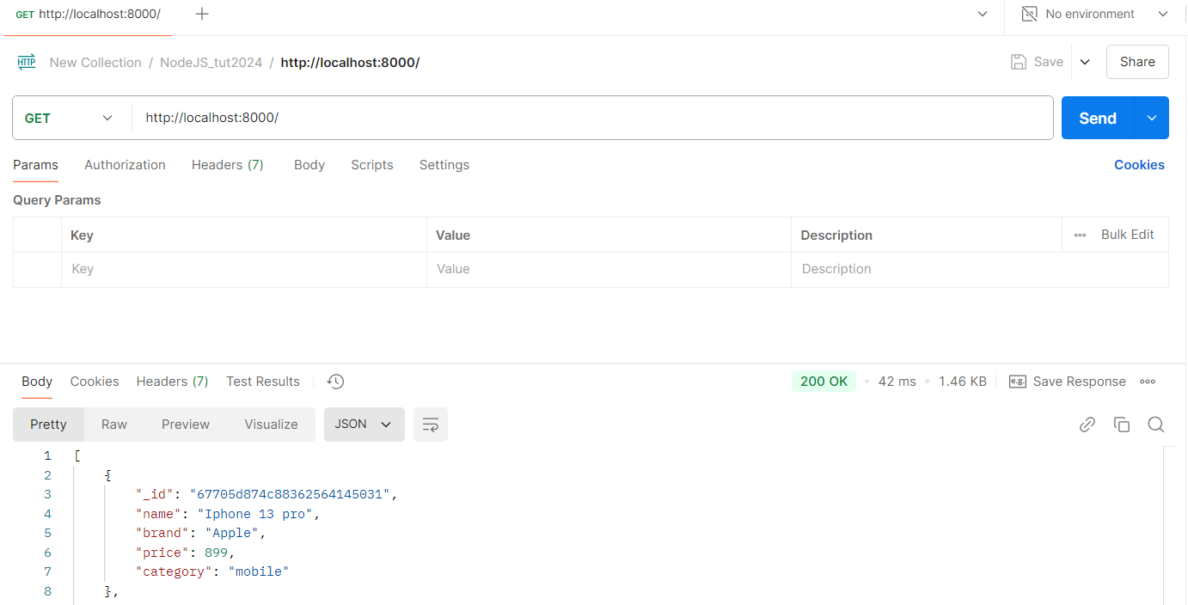
API with MongoDB
const express = require("express");
const dbConnect = require("./config/mongodb_config");
const app = express();
app.get("/", async(req, resp) => {
let dbData = await dbConnect();
dbData = await dbData.find().toArray();
//console.log(dbConn);
resp.send(dbData);
});
app.listen(8000);
Make new file for API.
Import and use Mongo Config.
Make API for get data.
Test with Postman.
Test on Postman

Slide 55
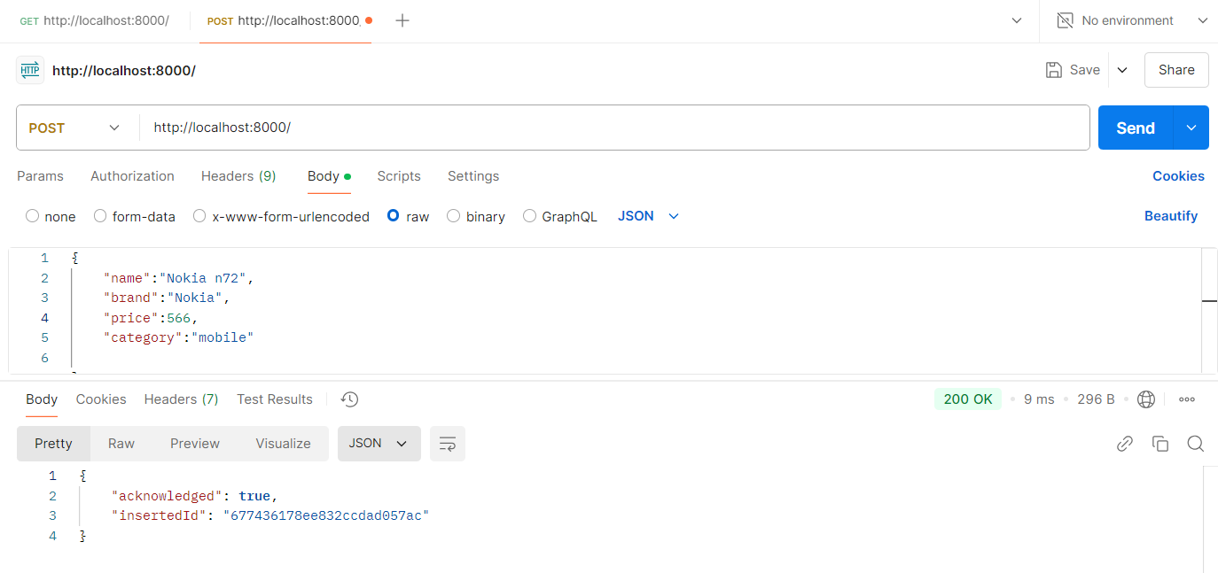
Node JS Post API Method
Make Post Method for API.
Send data from postman.
Get data in NodeJS by request.
Write code for insert data in MongoDB.
app.post("/", async (req,resp) => {
//let dbData = await dbConnect();
//console.log(req.body);
let dbData = await dbConnect();
let result = await dbData.insertOne(req.body)
resp.send(result);
})
app.listen(8000);
Test on Postman

Slide 56
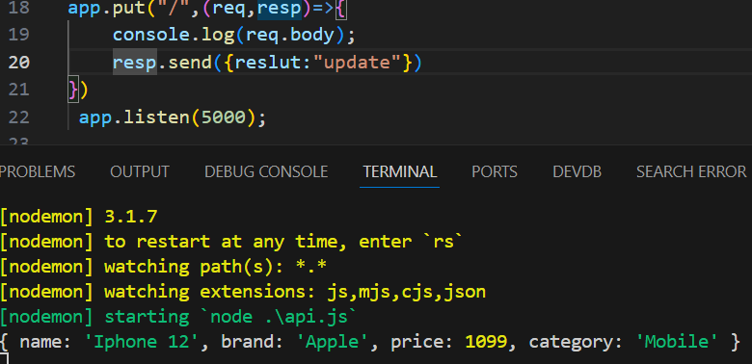
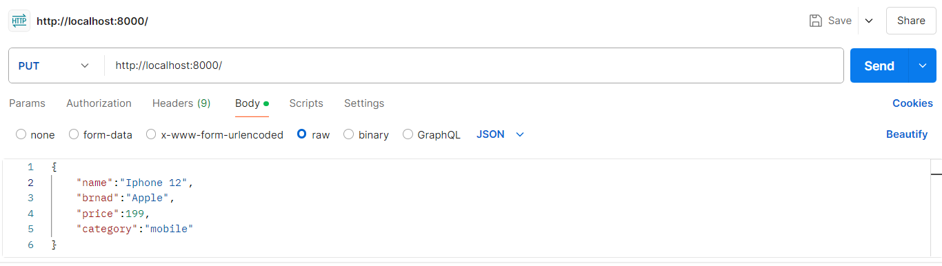
Node JS Put API Method
Send data from Postman
Output
Make Put method for API
Send data from Postman.
Handle data in NodeJS by request.
Write code for update data in MongoDB
app.put("/:name", async(req,resp) => {
let dbData = await dbConnect();
let result = await dbData.updateOne({name:req.params.name}, {$set:req.body});
console.warn(result);
resp.send({result:"updated"});//Dynamic Data
})
app.listen(8000);
app.put("/", async(req,resp)=>{
let data = await dbConnect();
let result = await data.updateOne(
{name : "Iphone 13"},{$set:{price:999}}//Static Data
)
console.log(result);
//resp.send({reslut:"update"})
})

Slide 57
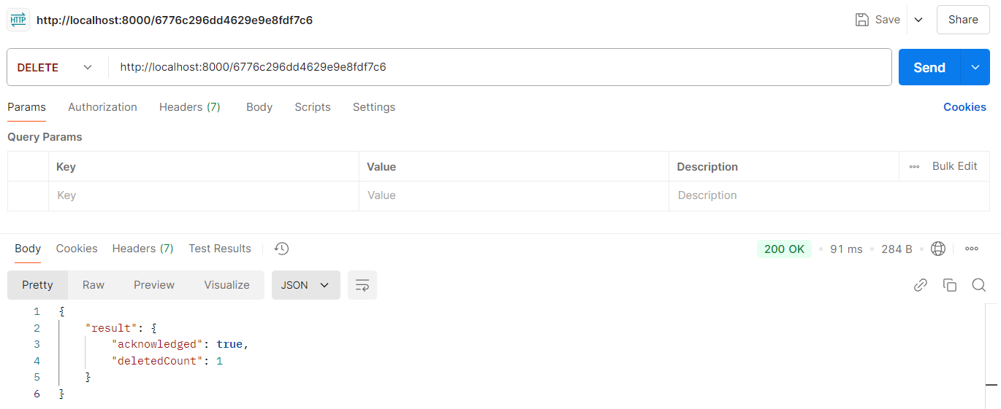
Node JS Delete API Method
Make delete method for API
Send data from Postman.
Handle data in NodeJS by request.
Write code for delete data in MongoDB
const mongondb = require('mongodb');
Mongodb instens
app.delete("/:id", async(req,resp) => {
let dbData = await dbConnect();
let result = await dbData.deleteOne({_id: new mongondb.ObjectId(req.params.id)});
resp.send({result:result});
})
app.listen(8000);

